Slide 1

SCHOOL OF COMPUTER SCIENCE AND ENGINEERING
REPORT ON PROJECT
Submitted to Lovely Professional University
In partial fulfillment of the requirement for the award of
“ BACHELOR OF TECHNOLOGY [COMPUTER SCIENCE AND ENGINEERING]”
Submitted By
Team NAME:-Debugging Dynamos
Time ID:-44

Slide 2
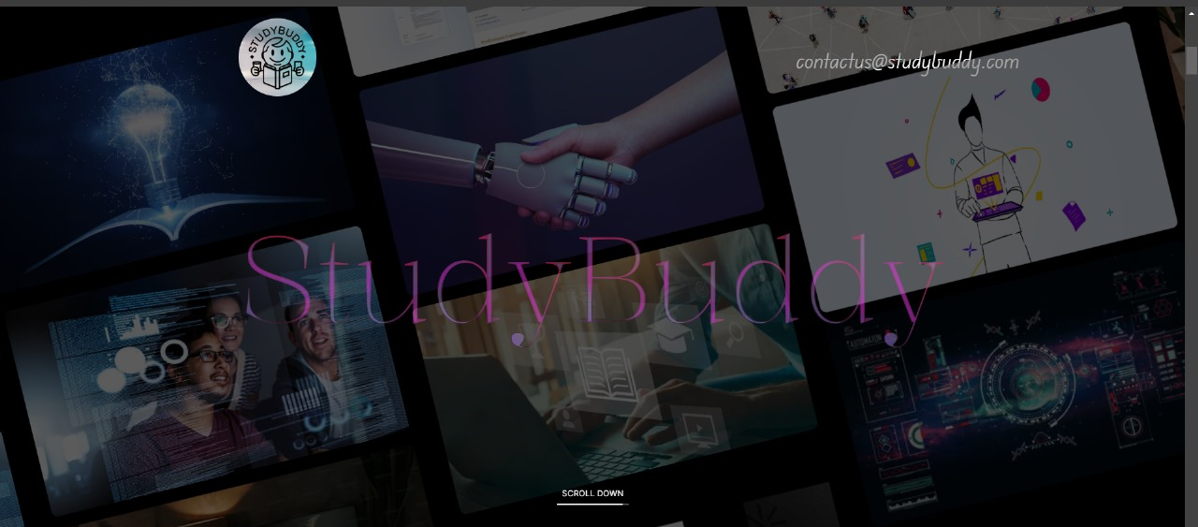
Problem Statement
Students, feel free to present Innovation as well, but please provide a thorough explanation of the idea.

Slide 3
STUDY BUDDY
STUDY BUDDY:A Personalized E-Learning Roadmap
Detailed Explanation of the Proposed Solution
Study Buddy features a user-friendly interface that allows students to easily navigate through their personalized learning roadmaps. The platform offers a variety of learning resources, including videos, quizzes, assignments, and discussion forums. Additionally, Study Buddy integrates gamification elements to keep students motivated, such as badges, leaderboards, and progress tracking.
The AI-driven recommendation engine continuously analyzes student performance and suggests content or exercises that align with their learning needs. Teachers and educators can also use the platform to monitor progress, provide feedback, and adjust the curriculum as necessary. The platform is accessible on multiple devices, ensuring that students can learn anytime, anywhere.

Slide 4
How It Addresses the Problem
The current e-learning landscape often fails to cater to individual learning needs, leading to disengagement and suboptimal outcomes. Study Buddy addresses this issue by offering personalized learning roadmaps that adapt to each student's unique pace and style of learning. By providing targeted resources and continuous feedback, the platform ensures that students remain engaged and make consistent progress.
Additionally, the platform’s collaborative tools foster a sense of community, allowing students to interact with peers and instructors, which addresses the isolation that can come with online learning.
Innovation and Uniqueness of the Solution
Study Buddy stands out from other e-learning platforms due to its use of advanced AI algorithms for personalization. Unlike traditional one-size-fits-all e-learning solutions, Study Buddy’s adaptive learning roadmaps ensure that students receive content tailored specifically to their needs.
The platform's gamification features further enhance engagement, making learning a more enjoyable experience. Moreover, the real-time analytics provided to educators allow for more informed and timely interventions, improving overall student success rates.
In summary, Study Buddy redefines the e-learning experience by focusing on personalization, engagement, and community, ensuring that every student can reach their full potential.

Slide 5
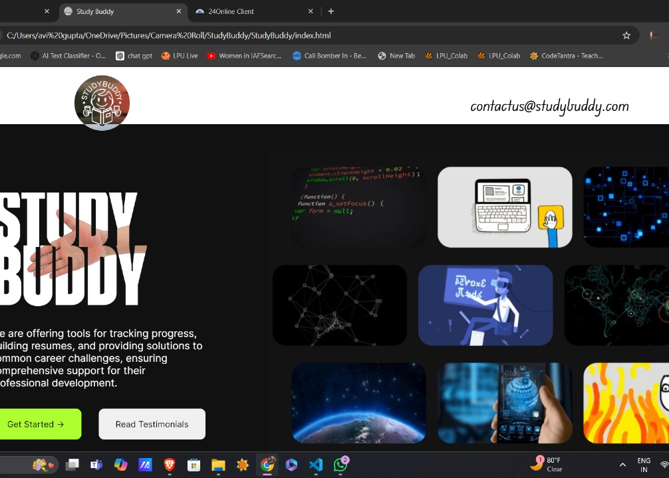
Proposed :-
Study Buddy is a dynamic e-learning platform designed to provide personalized learning roadmaps for students of all ages. The platform utilizes advanced AI algorithms to assess each student's strengths, weaknesses, and learning preferences, creating customized learning paths that adapt over time. With interactive modules, real-time feedback, and a wide range of multimedia resources, Study Buddy aims to make learning more engaging and effective.

Slide 6

TECHNICAL APPROACH
Front-End Development:
HTML5/CSS3: For structuring and styling the user interface, ensuring it is responsive and accessible across different devices.
JavaScript: For adding interactivity and dynamic content to the platform.
React.js: A popular JavaScript library used to build the user interface components, enabling a smooth and reactive user experience.
Bootstrap/Tailwind CSS: For responsive design and pre-built components to accelerate front-end development.
Back-End Development:
Node.js with Express.js: A powerful JavaScript runtime environment paired with a fast web framework for building the server-side logic, handling user requests, and managing data.
Python with Django/Flask: An alternative backend framework if more complex data processing or AI integration is required. Python is well-suited for incorporating AI algorithms that personalize learning roadmaps.

Slide 7
Database:
MongoDB: A NoSQL database that stores unstructured data, ideal for managing user profiles, course content, and progress tracking.
PostgreSQL/MySQL: For relational database requirements, particularly if the application needs to handle complex queries or transactions.
Artificial Intelligence/Machine Learning:
TensorFlow/PyTorch: Libraries for implementing AI algorithms that personalize the learning experience. They enable the system to analyze student behavior and generate personalized content.
Scikit-Learn: For more straightforward machine learning tasks like recommendation systems.
API Development:
RESTful APIs: For integrating the front-end with the back-end, ensuring smooth communication between different parts of the application.
GraphQL: An alternative for more efficient data querying and fetching if the application requires complex data interactions.

Slide 8
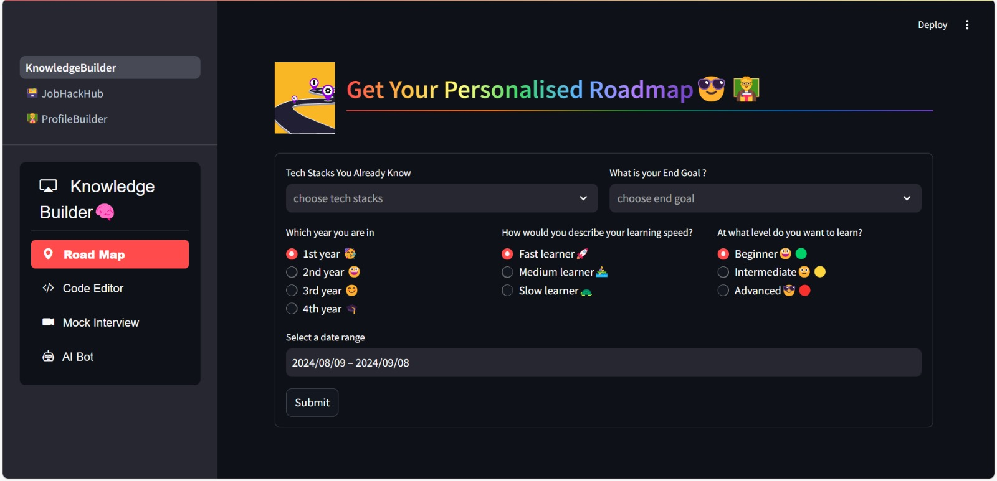
TECHNICAL APPROACH

Slide 9

Methodology and Process for Implementation
Requirement Analysis:
Identify the specific features required for the e-learning platform, including user authentication, content management, personalized learning roadmaps, gamification elements, and real-time feedback.
Define technical requirements, including scalability, security, and accessibility.
Design Phase:
System Architecture: Design the system architecture, detailing how different components (front-end, back-end, database, AI modules) will interact.
UI/UX Design: Create wireframes and prototypes using tools like Figma or Adobe XD. Focus on a user-friendly design that makes navigation intuitive for users of all ages.
Development Phase:
Front-End Development: Build the user interface using React.js and CSS frameworks like Bootstrap or Tailwind CSS.
Back-End Development: Implement server-side logic using Node.js/Express.js or Python/Django, handling API requests, user authentication, and database interactions.
Database Setup: Configure MongoDB or PostgreSQL, setting up collections/tables for users, courses, progress tracking, and more.
AI Integration: Develop and integrate AI modules for personalizing learning paths, leveraging machine learning libraries like TensorFlow or Scikit-Learn.

Slide 10

Testing Phase:
Conduct unit testing for individual components to ensure they work as expected.
Perform integration testing to verify that different components work together smoothly.
Use user acceptance testing (UAT) to gather feedback from potential users and make necessary adjustments.
Deployment:
Deploy the application on cloud platforms such as AWS, Google Cloud, or Azure, ensuring high availability and scalability.
Set up continuous integration/continuous deployment (CI/CD) pipelines using tools like Jenkins or GitHub Actions to automate testing and deployment.
Monitoring and Maintenance:
Use monitoring tools like Google Analytics, AWS CloudWatch, or New Relic to track user activity, application performance, and troubleshoot issues.
Regularly update the platform with new features, security patches, and performance improvements based on user feedback and changing requirements.

Slide 11
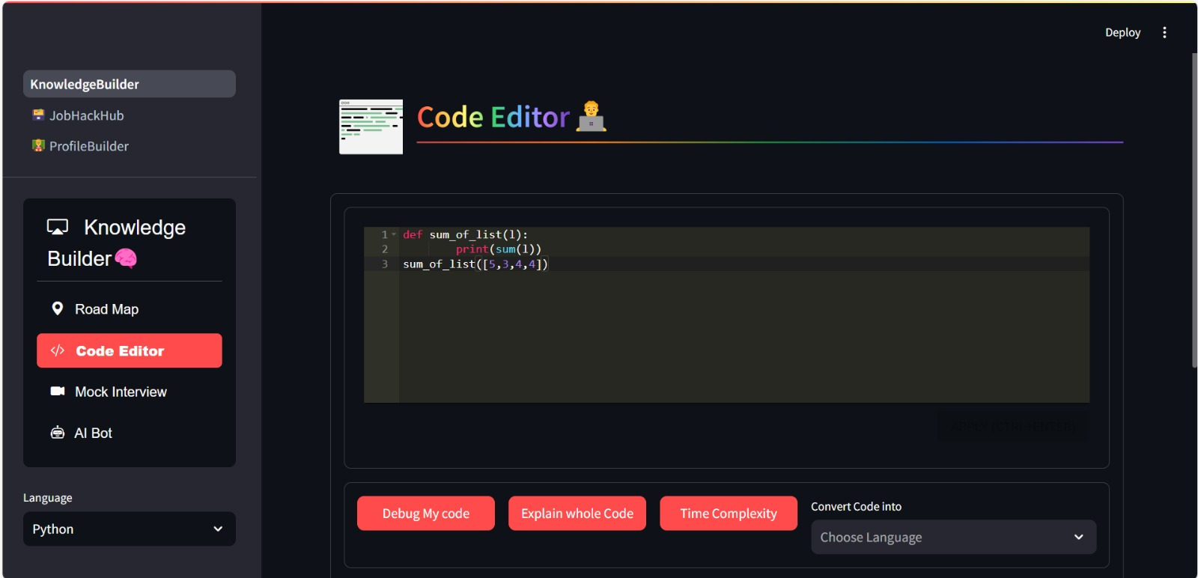

Slide 12

Methodology and Process for Implementation
Agile Development Process:
Sprint Planning: Break down the entire development process into smaller sprints (e.g., 2-week intervals). Each sprint focuses on specific features such as user authentication, content management, or AI integration.
Daily Stand-ups: Short meetings to discuss progress, blockers, and next steps.
Iteration and Feedback: After each sprint, gather feedback from the team and, if possible, a small group of users to make necessary adjustments.
Prototyping:
Start with low-fidelity wireframes to map out the user interface and core functionalities.
Progress to high-fidelity prototypes that simulate user interactions, created using tools like Figma or Adobe XD.
Implement a working prototype that demonstrates key features such as user registration, course content delivery, and AI-driven personalization.

Slide 13
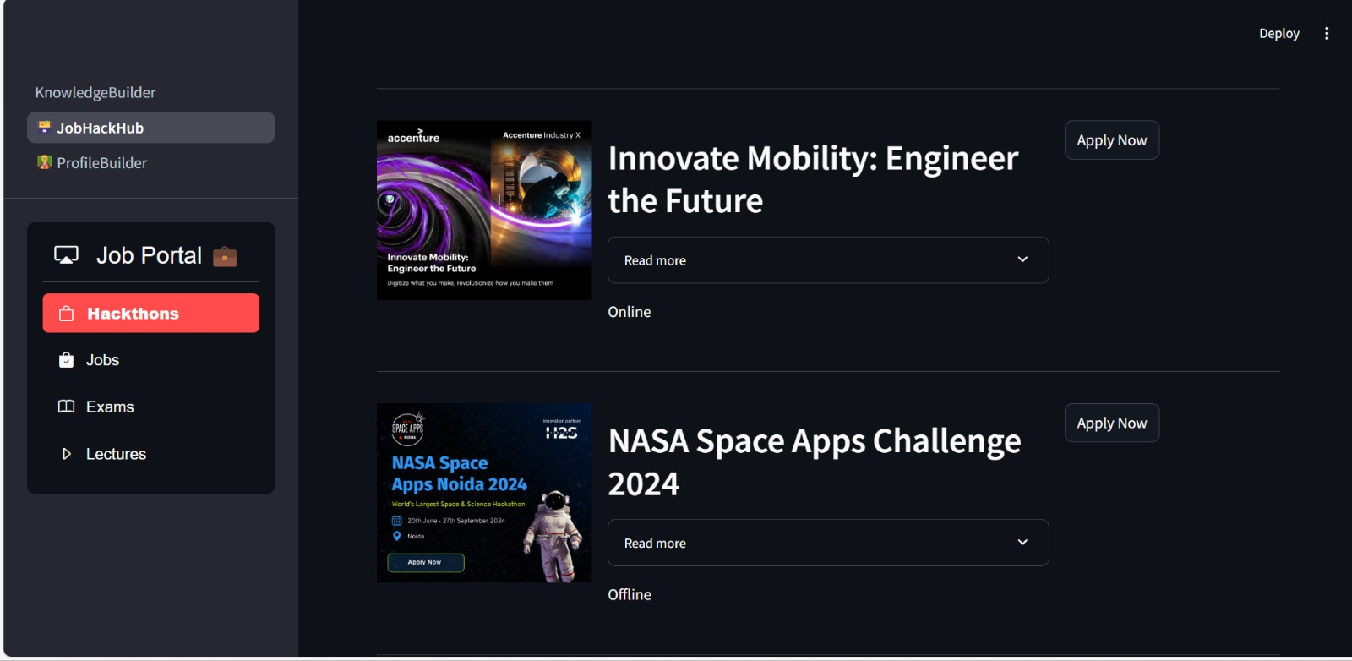

Slide 14
Implementation Process (Flow Chart Example):
User Registration/Login (User enters system) ↓
User Profile Setup (Collect learning preferences, goals, etc.) ↓
AI-Driven Roadmap Creation (Personalized learning paths) ↓
updates using Firebase.
Content Delivery (Modules, assessments, interactive lessons) ↓
Progress Monitoring (Track user progress and provide feedback) ↓
Continuous Learning & Updates (New content, challenges, certifications)
Technology Stack Implementation:
Front-End: Develop user interface components using React.js, HTML/CSS, and JavaScript.
Back-End: Build server-side logic with Node.js/Express or Python/Django.
Database: Implement MongoDB/PostgreSQL to manage user data, course content, and progress tracking.
AI/ML Integration: Personalize learning paths using libraries like TensorFlow or Scikit-Learn.
Deployment: Host the platform on AWS/GCP/Azure with real-time database

Slide 15
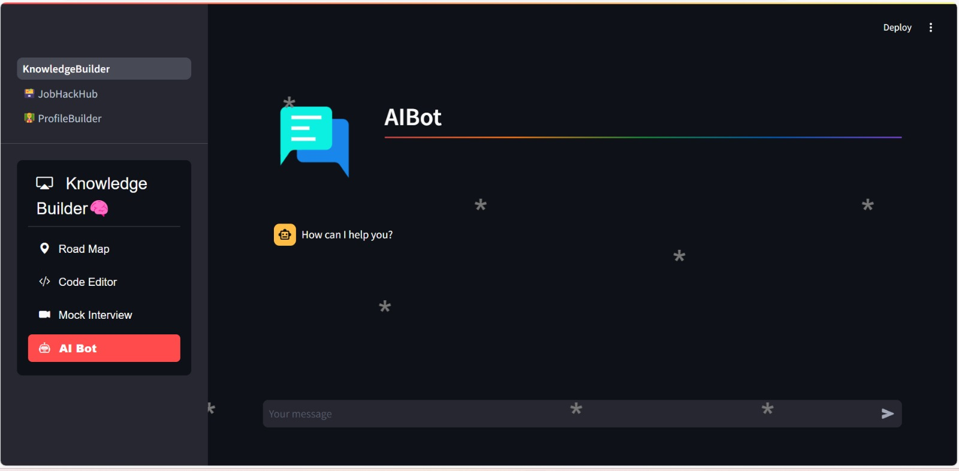
Chat Box
The e-learning platform will feature an AI-powered chatbot to enhance user engagement and provide real-time assistance. This chatbot will act as a virtual tutor, guiding students through course materials, answering queries, and offering personalized recommendations based on their progress. It will also support natural language processing, enabling seamless communication between users and the system. By integrating the chatbot into the platform, learners can receive instant feedback and support, making the learning experience more interactive, efficient, and tailored to individual needs. This ensures continuous learning and reduces the need for human intervention.

Slide 16

FEASIBILITY AND VIABILITY
Analysis of the Feasibility of the Idea:
Technical Feasibility:
The chosen tech stack (React, Node.js, MongoDB, etc.) is well-supported and scalable, ensuring that the platform can handle growth.
AI personalization algorithms can be efficiently implemented using available libraries.
Operational Feasibility:
Easy to integrate into existing educational systems.
The platform can be maintained with minimal overhead due to automated deployment and monitoring tools.
Market Feasibility:
The demand for e-learning is increasing, especially in the post-pandemic world. The target audience includes schools, universities, and corporations seeking digital learning solutions.
Potential Challenges and Risks:
Technical Challenges:
Complex AI integration may require significant computational resources.
Ensuring data security and privacy for users.

Slide 17

Operational Risks:
Continuous updates and content management can be resource-intensive.
Dependence on cloud infrastructure may lead to scalability or cost issues.
Strategies for Overcoming Challenges:
Technical Mitigations:
Use cloud-based AI services like AWS Sagemaker to manage computational requirements.
Implement strong encryption protocols and regularly update security measures.
Operational Mitigations:
Automate content updates through APIs and CMS tools.
Monitor cloud usage and optimize resource allocation to manage costs.

Slide 18
IMPACT AND BENEFITS
Potential Impact on the Target Audience:
Learners: Personalized learning experiences can lead to better engagement and higher retention rates.
Educators: Easier content management and student progress tracking allow for more efficient teaching.
Institutions: Scalability allows educational institutions to offer courses to a wider audience, increasing their reach and impact.
Benefits of the Solution:
Social Impact:
Promotes inclusive education by providing access to quality learning resources regardless of location.
Reduces educational disparities by personalizing learning for students of all skill levels.
Economic Impact:
Lower costs for both learners and institutions compared to traditional education.
Potential for monetization through subscriptions, certifications, or institutional partnerships.
Environmental Impact:
Reduces the carbon footprint associated with traditional education (e.g., paper usage, transportation) by moving to a digital platform.

Slide 19

RESEARCH AND REFERENCES
Details/Links of the Reference and Research Work:
User Experience Research:
Studies on personalized learning systems and their effectiveness (e.g., “The Impact of Personalized Learning on Student Outcomes” - Journal of Education Research).
AI in Education:
Reference to AI-based learning frameworks (e.g., “Implementing AI in Education: Opportunities and Challenges” - IEEE).
Technology Stack:
Best practices for using React.js and Node.js in scalable web applications (e.g., “Scaling React Applications” - Medium).
Market Analysis:
Reports on the growth of the e-learning industry (e.g., “E-Learning Market Size, Share & Trends Analysis Report” - Grand View Research).

